Slide 1
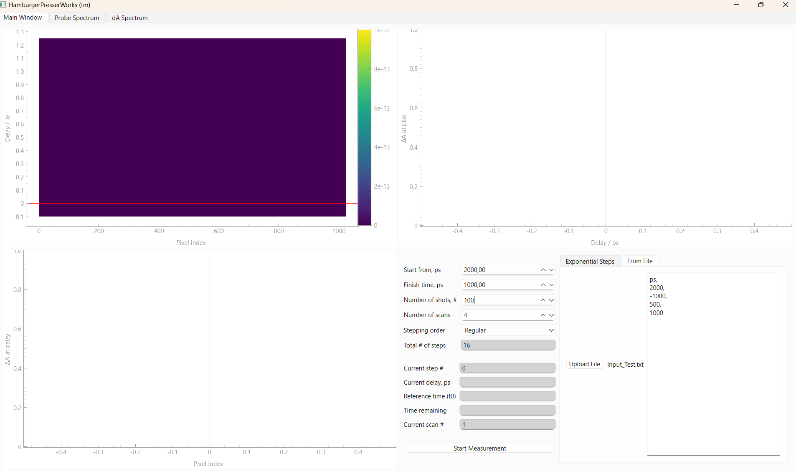

Slide 2
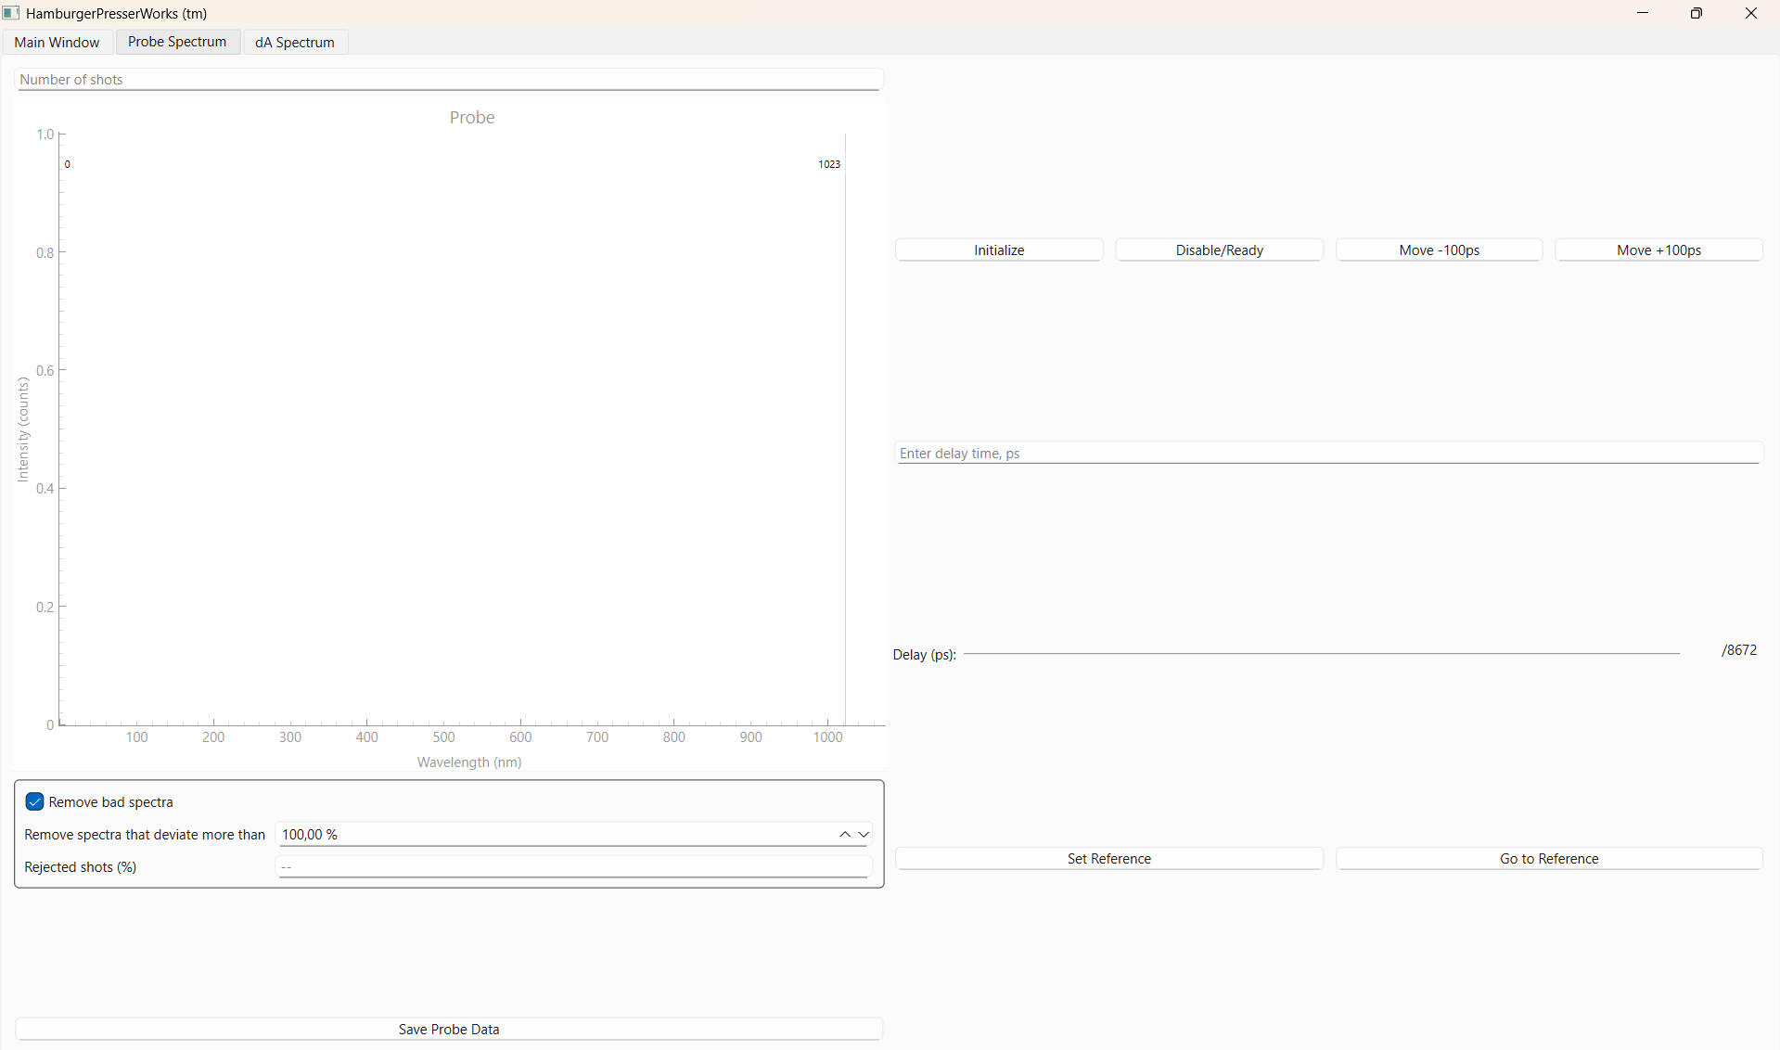
Real time updates

Slide 3
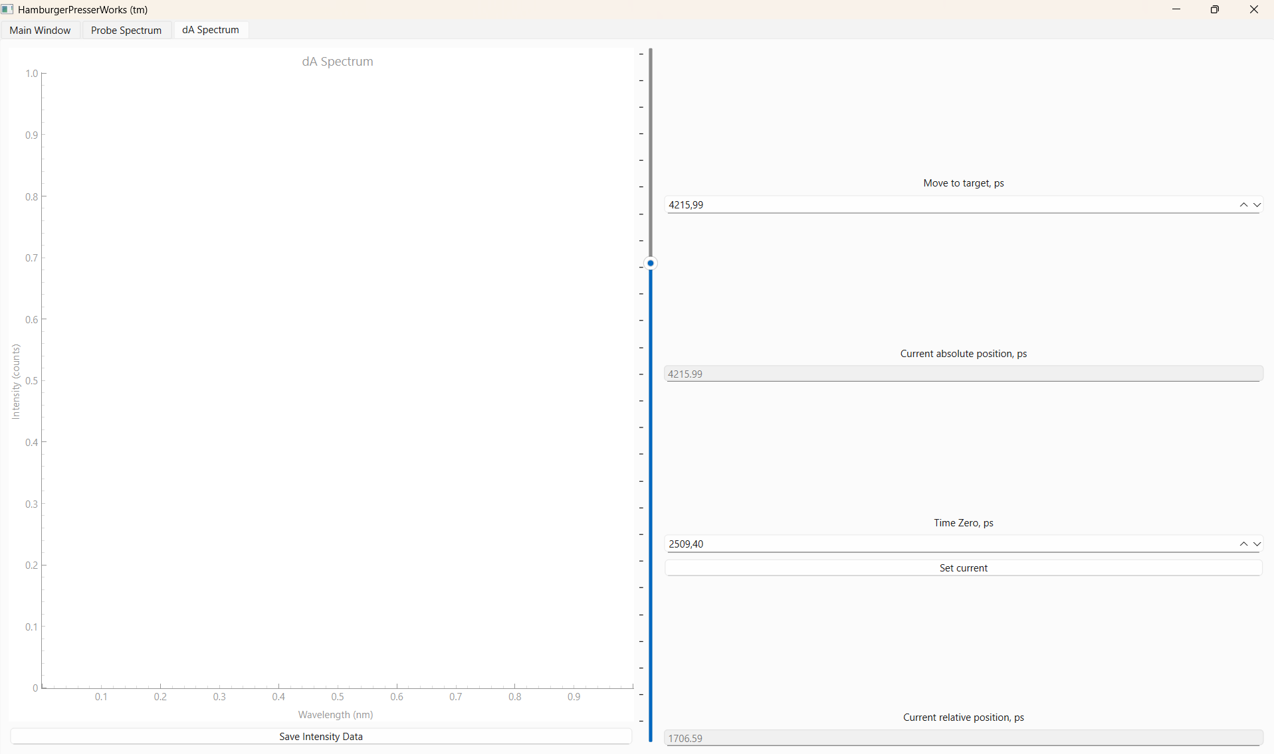
Real time updates

Slide 4
Sockets
Communication between CPython and IronPython(C#)

Slide 5
Socketing
Server side
Client side
“Host” & “Port”
Server
Client

Slide 6
Socketing
Server Listens
Client searches
Server
Client

Slide 7
Socketing
Server Listens
Client searches
Server
Client

Slide 8
Socketing
(1) sends message
(2) receives
(2) uses message
(2) sends message
(1) receives
Server
Client

Slide 9
IronPython
Start Measurement
Connection
Main Window (WorkerProcess)
WorkerThread
List
IronPython
Calcs
WorkerThread
Updates
Next Step
IronPython
GUI
Calcs

Slide 10
Socketing:
Significant speed up of measurements
From >2.5s to <0.8s
On start up takes longer for GUI updates
GUI still freezes
Complicates code

Slide 11
Next steps:
Speeding up heatmap (Bas)
Optimizing GUI start up (Jarod)
File saving

Slide 12
Commands
Data update
Errors
Background
Measurements
Validation/upkeeping
Plotting
Axis update
UI update
Heatmap window
Camera_gui
dA Window:
run_command
Main Interface:
trigger_worker
parsed_content
DLS Window:
run_command
ProbeThread:
Probe_update
dA_update
WorkerThread:
Measurement_data_update
Update_delay_bar
Update_ref
Error_occurred
Update_probe
Update_dA
Start_process
Plot_row_update
Probe window (DLS)
dA Window
Main_window
WorkerThread

Slide 13
Heatmap window
Camera_gui
Probe window (DLS)
dA Window:
run_command
Main Interface:
trigger_worker
parsed_content
DLS Window:
run_command
ProbeThread:
Probe_update
dA_update
dA Window
Main_window
WorkerThread

Slide 14
Heatmap window
Probe window (DLS)
Plot_row_update
Measurement_data_update
Update_delay_bar
Update_ref
Update_probe
Update_dA
Start_process
Main_window
dA Window
WorkerThread

Slide 15
Heatmap window
Main_window
Probe window (DLS)
Update_delay_bar
Error_occurred
dA Window

Slide 16
Neutral Density Filter
640 nm diode laser 25 KHz
Camera
Delay Stage
520 nm diode laser 50 KHz

Slide 17
Pockels Cell
ORPHEUS
Pump 25 KHz
LYRA
Delay Stage
PHAROS
Fundamental
White light generation
Probe 50 KHz
Sample
Spectrograph

